Slide 1
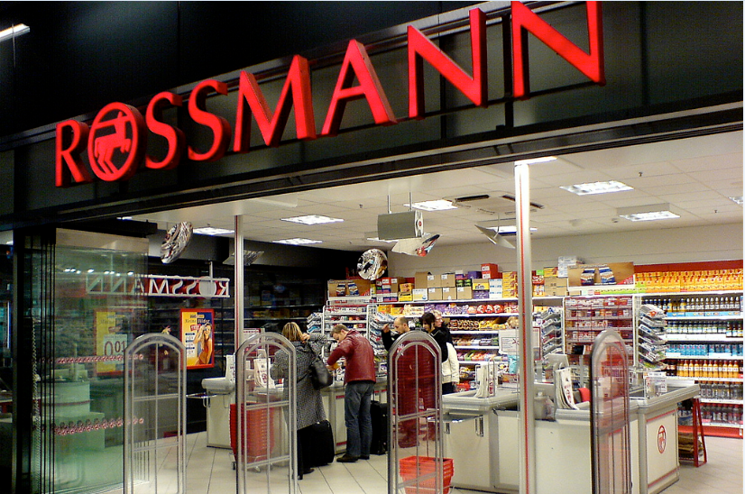
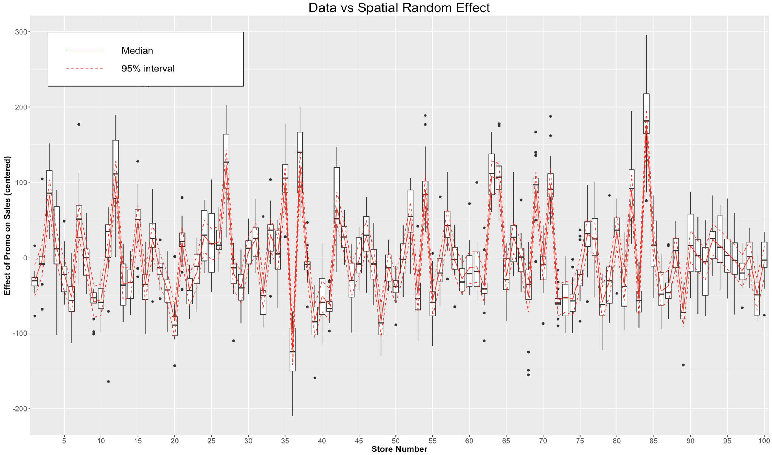

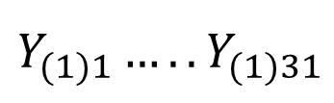


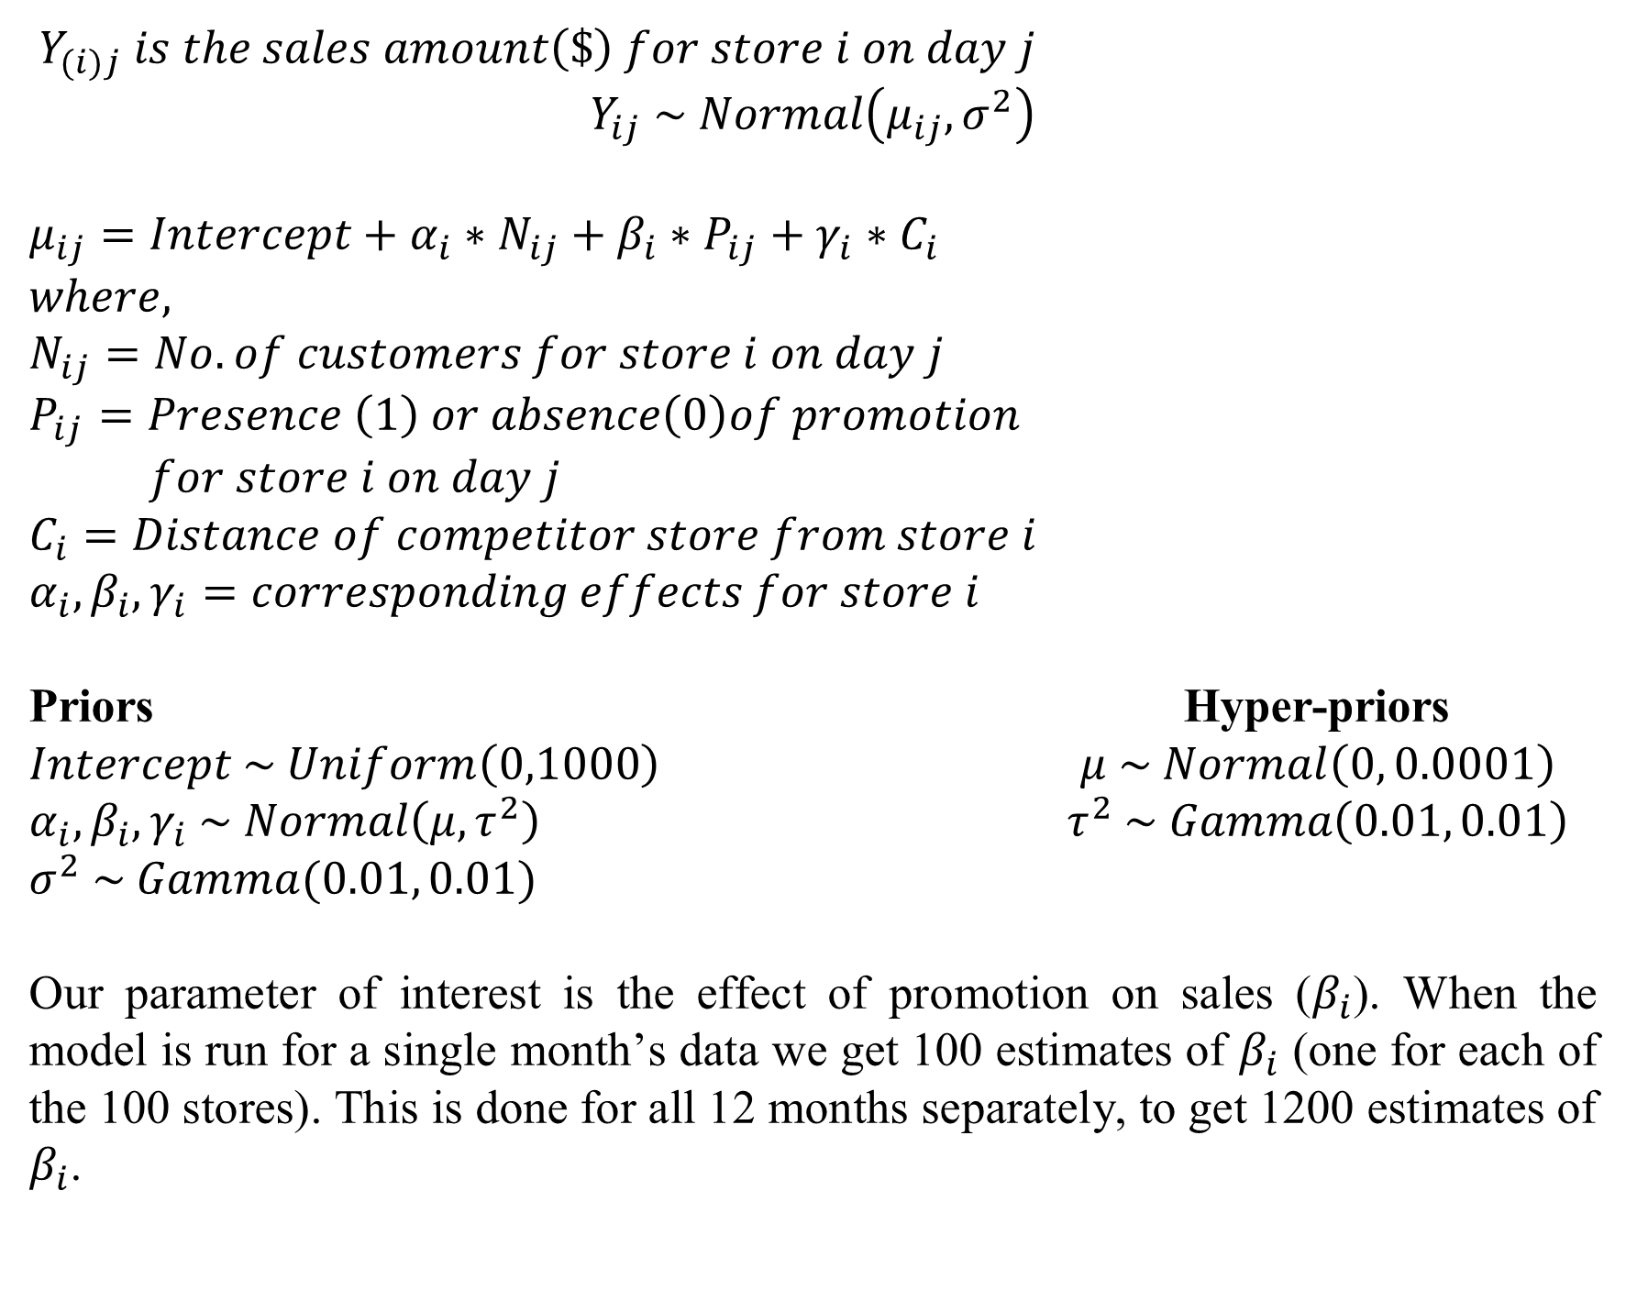


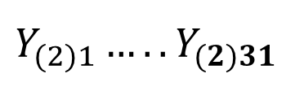

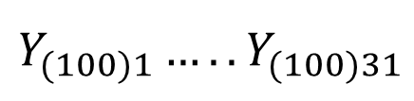

Bayesian Modeling for Spatio-Temporal Effects on Promotional Effectiveness
Bhavadhaarini Balasubramanianª, Rohit Dongaonkarª, Jason Matney^{b}
North Carolina State University ªDepartment of Integrated Manufacturing Systems Engineering ^{b}Department of Forestry and Environmental Resources
INTRODUCTION
Part 1: Hierarchical Model
$${ Y}_{(i)j} is the sales amount\left(\$\right) for store i on day j$$
$$Y_{ij} \sim Normal\left(μ_{ij},σ^{2}\right)$$
$$μ_{ij}=Intercept+α_{i}∗N_{ij}+β_{i}∗P_{ij}+γ_{i}∗C_{i}$$
$$where,$$
$$N_{ij}=No. of customers for store i on day j$$
$$P_{ij}=Presence \left(1\right) or absence\left(0\right)of promotion$$
$for store i on day j$
$$C_{i}=Distance of competitor store from store i$$
$$α_{i}, β_{i}, γ_{i}=corresponding effects for store i$$
Priors Hyper-priors
$$Intercept \sim Uniform\left(0,1000\right) μ \sim Normal\left(0, 0.0001\right)$$
$$α_{i}, β_{i}, γ_{i} \sim Normal\left(μ,τ^{2}\right) τ^{2} \sim Gamma\left(0.01, 0.01\right) \\ σ^{2} \sim Gamma(0.01, 0.01)$$
Our parameter of interest is the effect of promotions on sales ($β_{i}$). When the model is run for a single month’s data we get 100 estimates of $β_{i}$ (one for each of the 100 stores). This is done for all 12 months separately, to get 1200 estimates of $β_{i}$.
RESULTS
The relative contribution of spatial, temporal and error variance is summarized in Figure 2. From our analysis, we found that the store’s location plays a more significant role than the month of promotion in determining its effectiveness.
Rossmann - Germany's second-largest drugstore chain - operates over 3000 stores in 7 European countries. Store sales are influenced by many factors, including promotions, competition, holidays, seasonality, and locality. Among these factors, Rossmann has control over the promotions conducted across its stores. The effectiveness of promotions depends on the store and the time of year.
Figure 2
Figure 3. illustrates the high variability across store locations
OBJECTIVES
The first part of this study aims to estimate the effect of promotions on sales at each store, for every month, using a Bayesian hierarchical model. These results are used as inputs for the second part of the analysis. In the second part, we study how the effect of promotions on sales varies in space (store location) and time (month) using a spatiotemporal random effects model.
The results will tell us whether the effect of promotions on sales is affected more by the store location or by the month of promotion. This information can be used by Rossmann to maximize sales to drive decisions such as:
Conducting promotions at particular stores over all months of year
Conducting promotions at all stores in particular months of year
Part 2: Spatio-Temporal Random Effects Model
In this part the relative contributions of spatial and temporal random effects to the total variability in effectiveness of promotions are examined using the estimates from part 1. A two-way random effects model is used:
$$E_{ij}=Normal\left(μ+α_{i}+γ_{j}, σ_{e}^{2}\right)$$
$$where,$$
$$E_{ij}= effect of promotion on sales at store i in month j, \\ μ=intercept$$
$$α_{i}=spatial random effect (store location) \\ γ_{i}=temporal random effect\left(month\right) \\ σ_{e}^{2}=error variance$$
Random effects Priors $$α_{i} \sim Normal\left(0, σ_{s}^{2}\right) μ \sim Normal(0,0.0001) \\ γ_{i} \sim Normal\left(0, σ_{t}^{2}\right) { σ}_{e}^{2},σ_{s}^{2}, σ_{t}^{2} \sim InvGamma(0.1, 0.1)$$
ANALYSIS
Figure 3
Directed Acyclic Graph
CONCLUSION
Promotions have an associated cost with them. Therefore, to maximize sales with minimal promotions Rossmann’s should focus more on the spread of promotions across stores rather than the month of promotion.
$$σ^{2}$$
FUTURE DIRECTIONS
In this study we only consider the presence or absence of promotion, but not the magnitude of promotion. It is a reasonable to assume that some stores might have discounted their prices more than other stores during their promotions. Depending on this magnitude of promotions, the effect of promotion on sales will be different. The high contribution of spatial variation may be due to this aspect. In future studies, information about the magnitude of promotions should be included by measuring promotions on an ordinal scale instead of a binary scale. This will give a much better insight into the effectiveness of promotions with respect to location and time.
Store1
Store 2
..…
Store 100
$$Y_{(1)1}…..Y_{(1)31}$$
$$Y_{(2)1}…..Y_{(2)31}$$
$$Y_{(100)1}…..Y_{(100)31}$$
$$θ_{1}$$
$$θ_{2}$$
$$θ_{100}$$
$$μ, τ^{2}$$
REFERENCES
[1] "Rossmann Store Sales." Accessed April 10, 2016. https://www.kaggle.com/c/rossmann-store-sales.
Figure 1.
Daily sales data of 100 stores in 2013 is used for analysis

